Slide 1
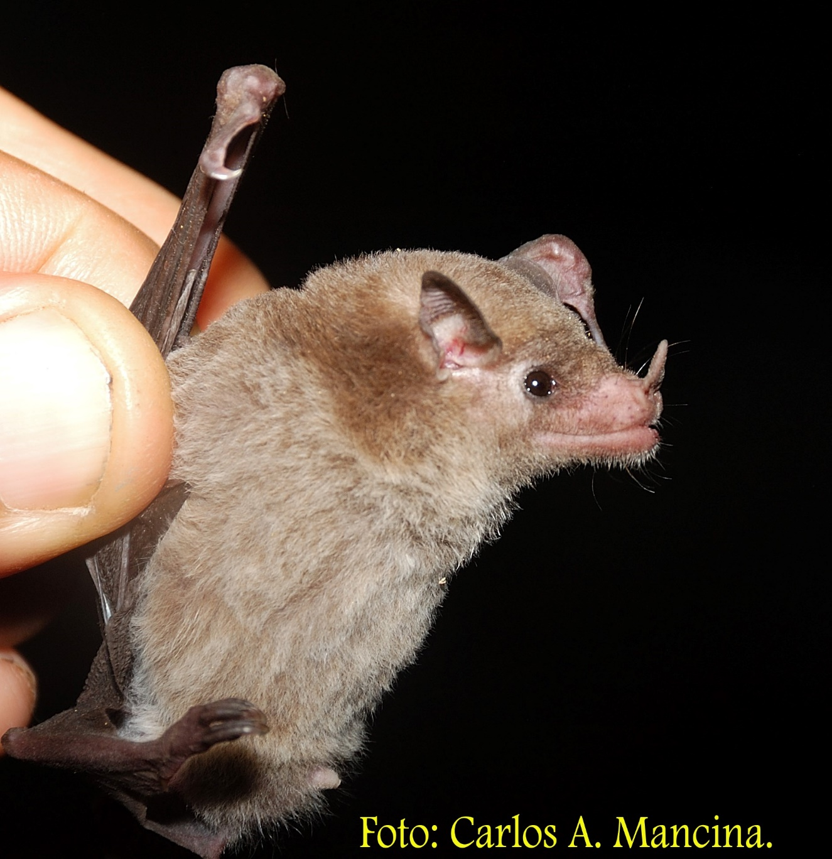
Monophyllus redmani (Leach’s single leaf bat)
Distribution: This species is endemic to the Greater Antilles and is the only Cuban bat from the subfamily Glossophaginae. There are three subspecies recognized in the New World, of which only Monophyllus redmani clinedaphus occur in Cuba. This species can also be found on Española and the Bahamas. It is widely distributed throughout Cuba, including Isla Juventud. This species is common in various types of habitats, ranging from evergreens and secondary forests, to fruit plantations, such as banana and guayaba, where it feeds off the flowers.
Physical description: This species weighs 9-12 g with a forearm length of 38-42 mm. Their eyes are proportionately large, and the rostrum is elongated and slender. The nose leaf is small, and pointed, but well-formed. The fur can range from dark brown to various shades of grey.
Roosts: They roost in large aggregations in the most humid and darkest zones within a cave. The groups prefer to roost within the ceiling structures called bell cavities.
Diet: Out of all the insectivorous bat species in Cuba, this species is the most specialized in feeding on flowers. With its’ low weight, slender snout, protractile tongue, and wing morphology, this species can access flowers that other species cannot. In addition to nectar, they also feed on insects to add protein to their diet.

